Slide 1
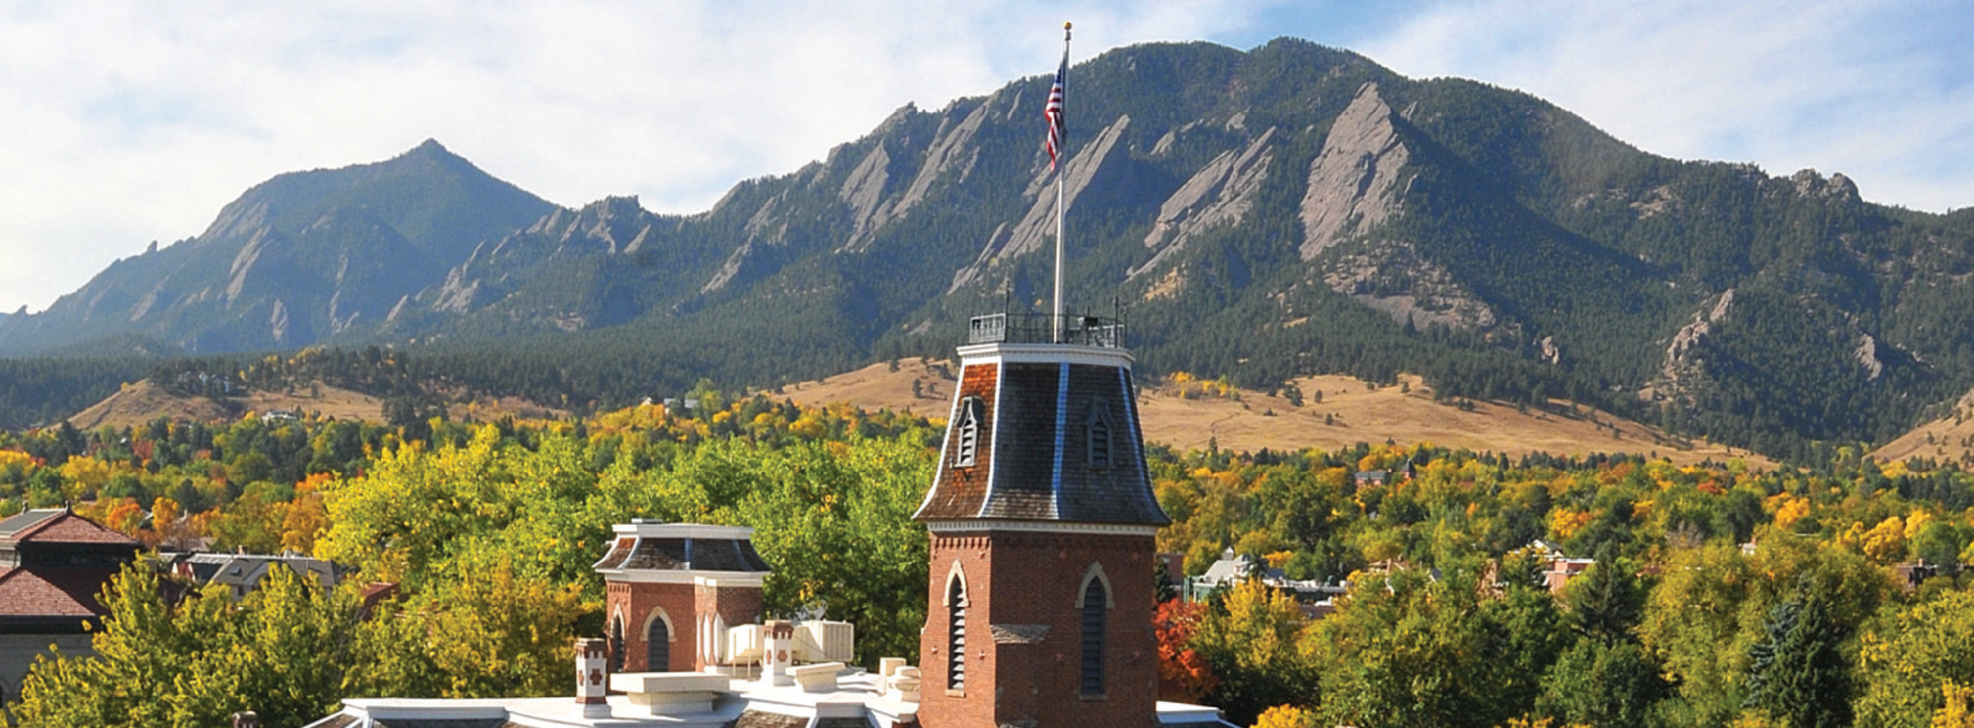
Research Storage Simplified
Research Storage Simplified
John Reiland

Slide 2

View the Slides
https://github.com/ResearchComputing/research_storage_simplified

Slide 3

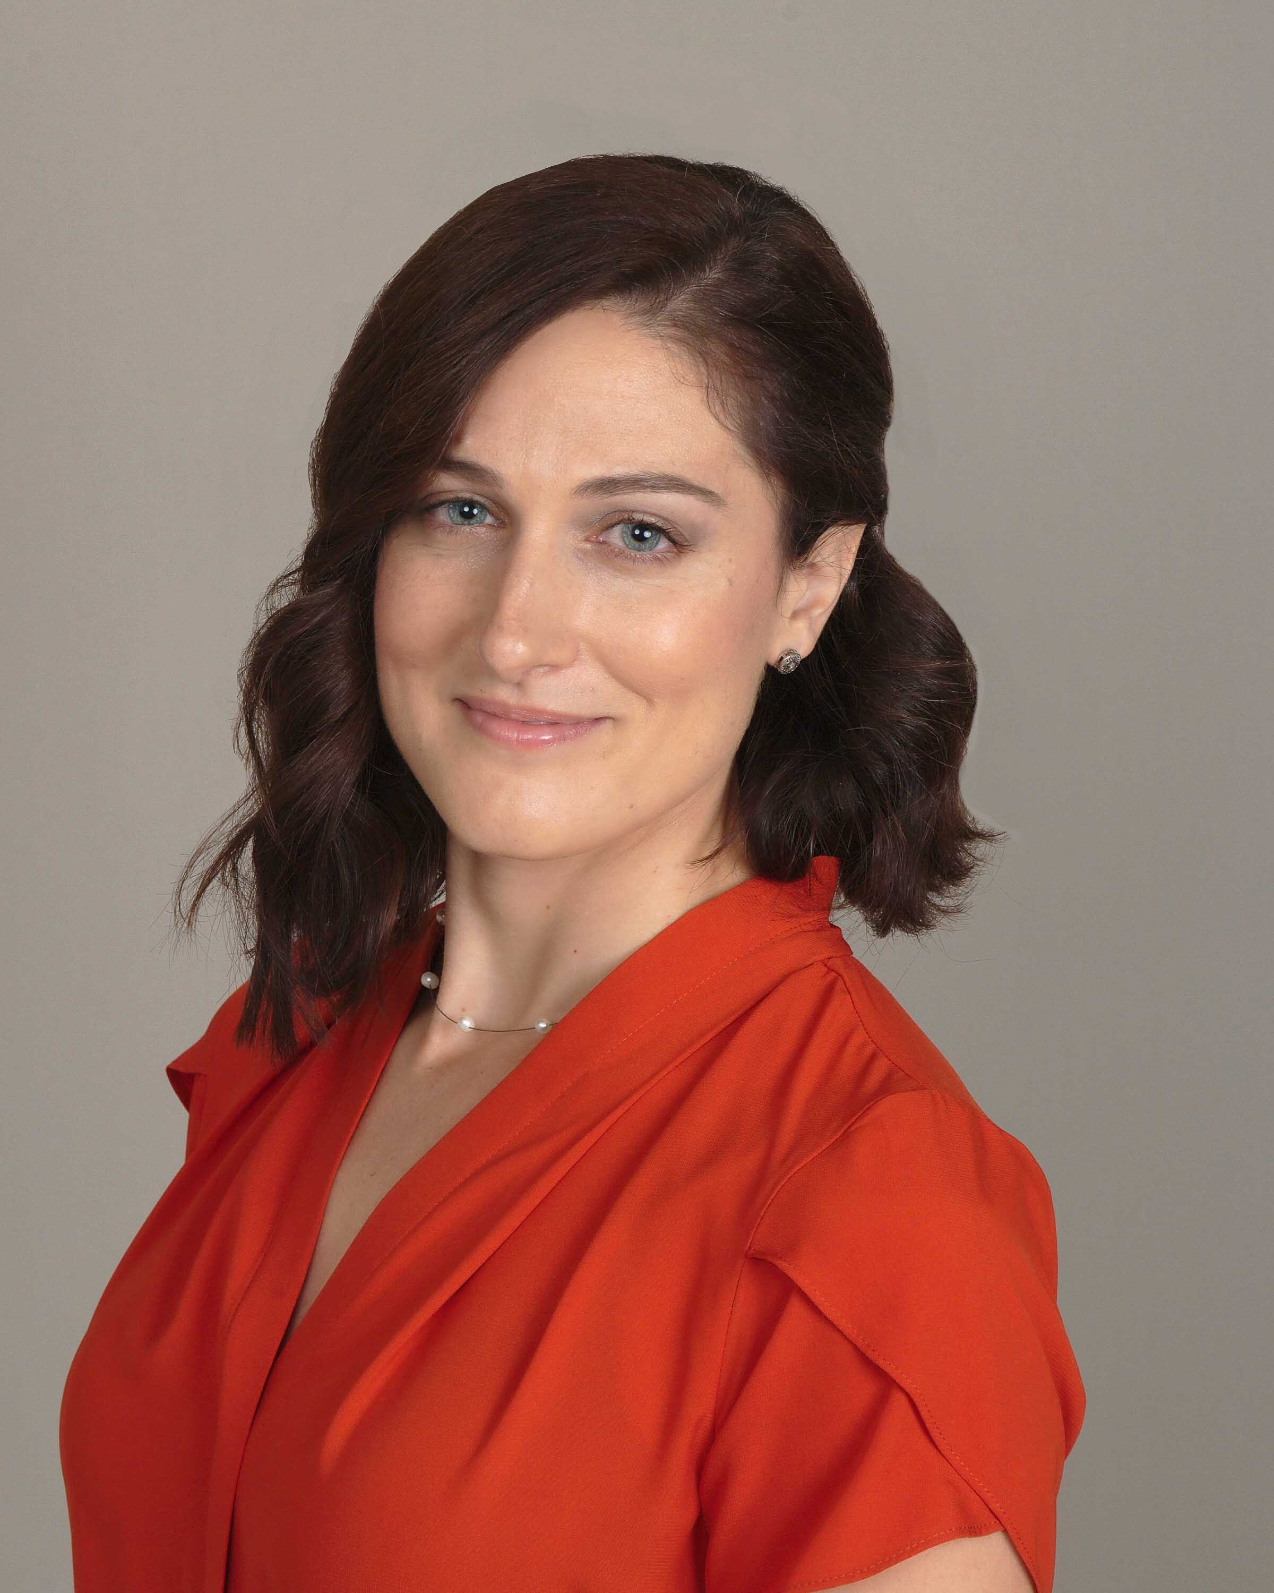
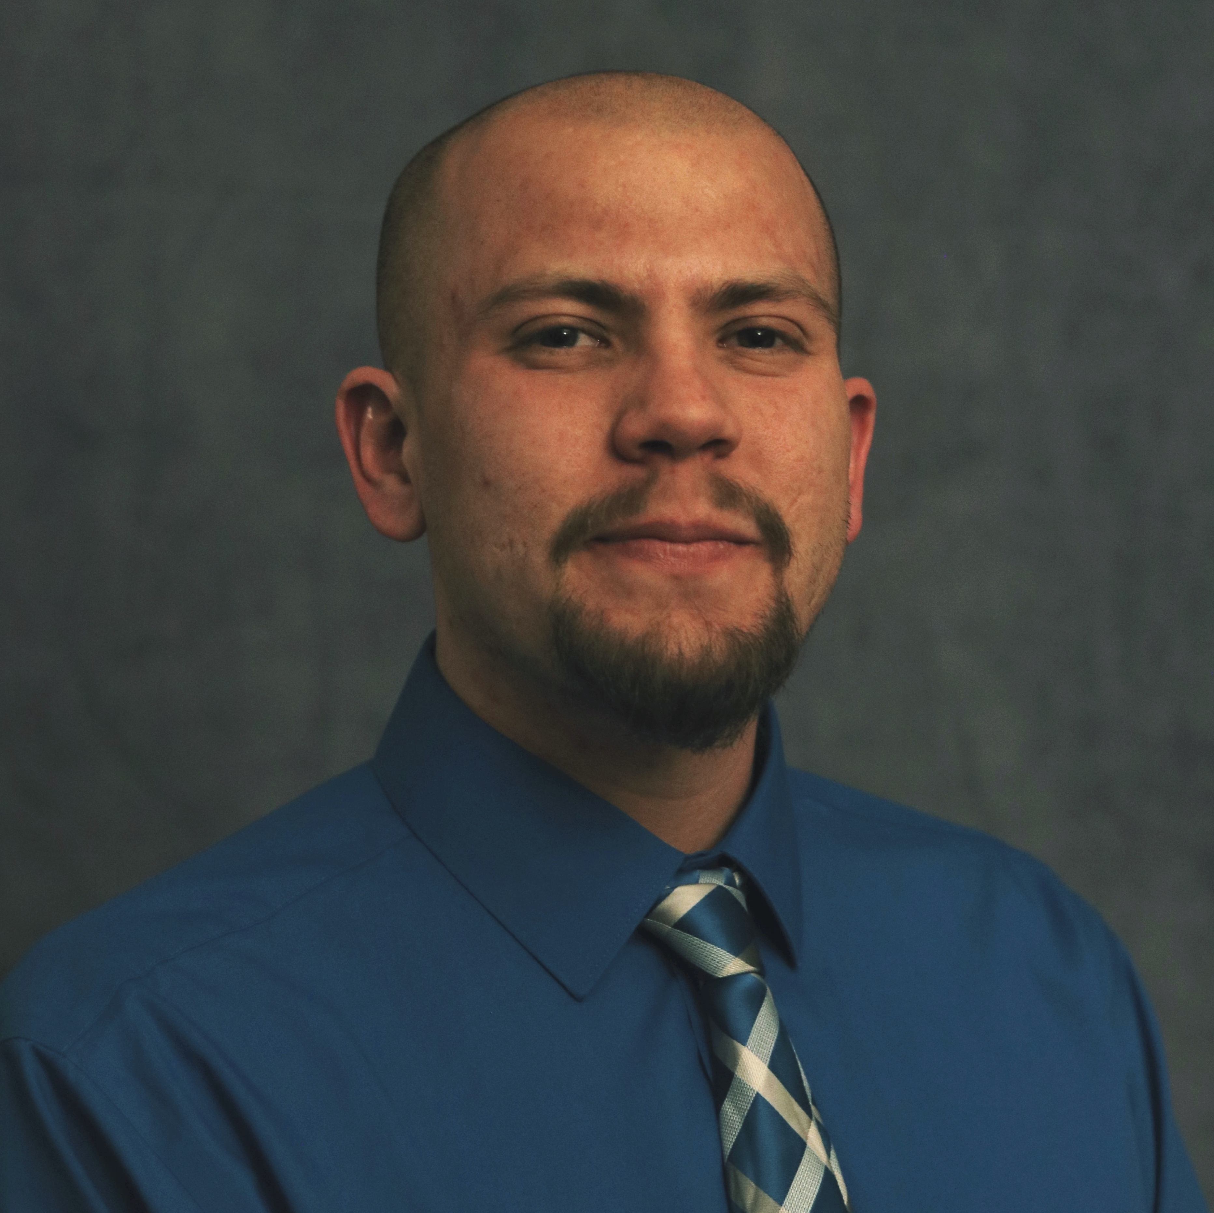
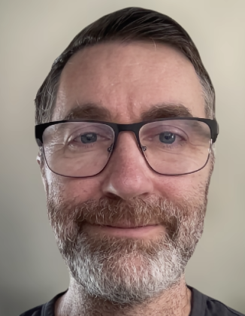


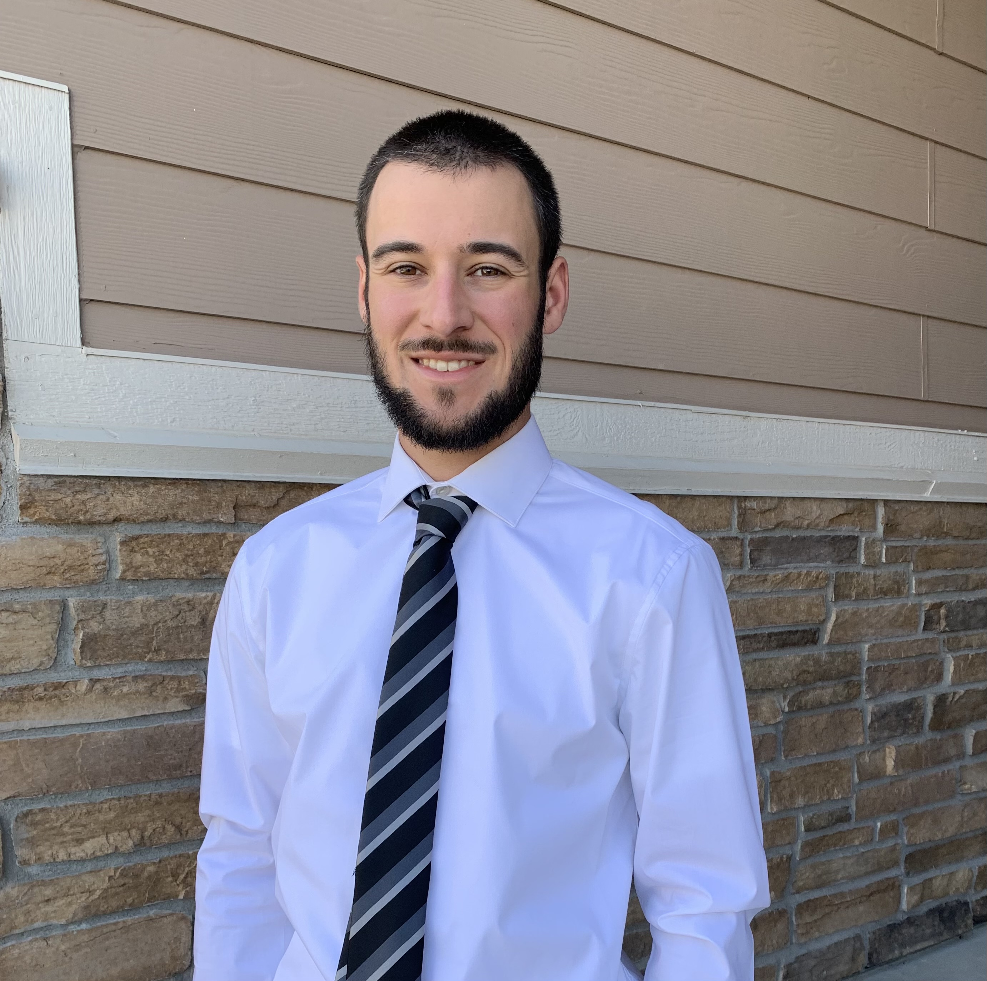


Meet the User Support Team
Layla Freeborn
Brandon Reyes
Andy Monaghan
Michael Schneider
John
Reiland
Dylan Gottlieb
Mohal Khandelwal
Ragan
Lee
3

Slide 4

Data Storage
Core
Personal Storage
Includes 3 Directories
/home (2 GB)
/projects (250 GB)
/scratch (10 TB)

Slide 5
Data Storage
Core
PL
PetaLibrary
Tiered Storage
Active, Archive, Active+Archive, Archive+DR
Requires Funding
Starts at 1 TB
Personal Storage
Includes 3 Directories
/home (2 GB)
/projects (250 GB)
/scratch (10 TB)

Slide 6
Core
Home
Personal data
Config files
OnDemand data
Do not share!
2 GB
Notes:
Documentation on Filesystem/Storage: https://curc.readthedocs.io/en/latest/compute/filesystems.html

Slide 7
Core
Home
Projects
Personal data
Config files
OnDemand data
Do not share!
Code, Job scripts
Installed software
Shared data
2 GB
250 GB
Notes:
Documentation on Filesystem/Storage: https://curc.readthedocs.io/en/latest/compute/filesystems.html

Slide 8
Core
Home
Projects
Scratch
Personal data
Config files
OnDemand data
Do not share!
Code, Job scripts
Installed software
Shared data
Job data (in/out)
Shared data
Deleted after 90 days
2 GB
250 GB
10 TB
Notes:
Documentation on Filesystem/Storage: https://curc.readthedocs.io/en/latest/compute/filesystems.html

Slide 9
More Details on Scratch
/alpine
/local
Specific to each compute node
Accessible only on that node, while a job is running on it
Available from all nodes
Accessible even when no jobs are running

Slide 10
PetaLibrary
Active
Performance tier
Accessible by all nodes
No file limit
Notes:
Documentation on PetaLibrary: https://curc.readthedocs.io/en/latest/storage/petalibrary/index.html

Slide 11
PetaLibrary
Active
Archive
Performance tier
Accessible by all nodes
No file limit
Integrity tier
Accessible by data transfer (DTN) and login nodes only
10,000 File Limit
Notes:
Documentation on PetaLibrary: https://curc.readthedocs.io/en/latest/storage/petalibrary/index.html

Slide 12
PetaLibrary
Active + Archive
Same features as Active
Copy is synced to separate on campus datacenter every 15 mins.
Active
Archive
Performance tier
Accessible by all nodes
No file limit
Integrity tier
Accessible by data transfer (DTN) and login nodes only
10,000 File Limit
Notes:
Documentation on PetaLibrary: https://curc.readthedocs.io/en/latest/storage/petalibrary/index.html

Slide 13
PetaLibrary
Active + Archive
Same features as Active
Copy is synced to separate on campus datacenter every 15 mins.
Active
Archive
Performance tier
Accessible by all nodes
No file limit
Integrity tier
Accessible by data transfer (DTN) and login nodes only
10,000 File Limit
Archive + DR
Same features as Archive
Copy is synced to offsite datacenter monthly
Notes:
Documentation on PetaLibrary: https://curc.readthedocs.io/en/latest/storage/petalibrary/index.html

Slide 14
Speed Comparison
/scratch/local: Fastest
/scratch/alpine: 2nd Fastest
PetaLibrary (all tiers): 3rd Fastest
/projects: 4th Fastest
/home: Slowest

Slide 15


Data Sharing: Within RC
/home ← Private!!!
/projects
/scratch
PetaLibrary Space
Notes:
*Users can manage access to their /project and /scratch directories by submitting a ticket for changes.
RC Staff manage access to the PetaLibrary Space

Slide 16
Data Sharing: Outside RC
Large Data Transfers:
Globus (Recommended)
Data Transfer Nodes (DTN)
Terminal/Command Line:
rsync
rclone (connect to 3rd party cloud services like OneDrive)
sftp
scp
Notes:
DTN require internal CU Network access (VPN)

Slide 17

Data Transfer Nodes
DATA (DTN)
Support data transfers
Most robust data transfer method
Can be selected when using scp, sftp, or ssh transfers

Slide 18
Acceptable data storage and use
CURC systems and services should not be used to store any data that is US government Classified, nor any Controlled Unclassified Information.
For users requiring storage for sensitive data types, please see the secure research computing resources:
https://www.colorado.edu/rc/secure-research-computing-resources

Slide 19

Documentation
https://curc.readthedocs.io/en/latest/

Slide 20

Survey and feedback
Survey: http://tinyurl.com/curc-survey18

